Slide 1
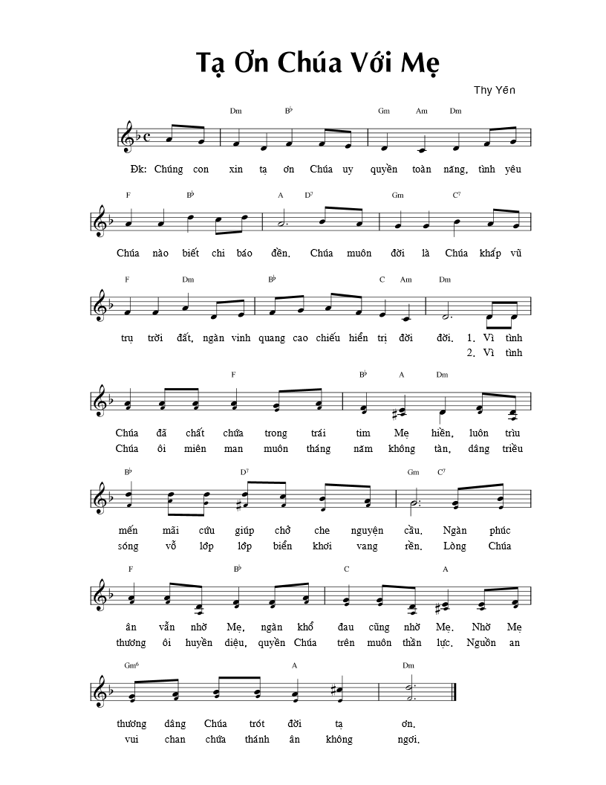
1, 2, 3
2, 3
2, 3

Slide 2
2, 3
2, 3, 4

