Slide 1
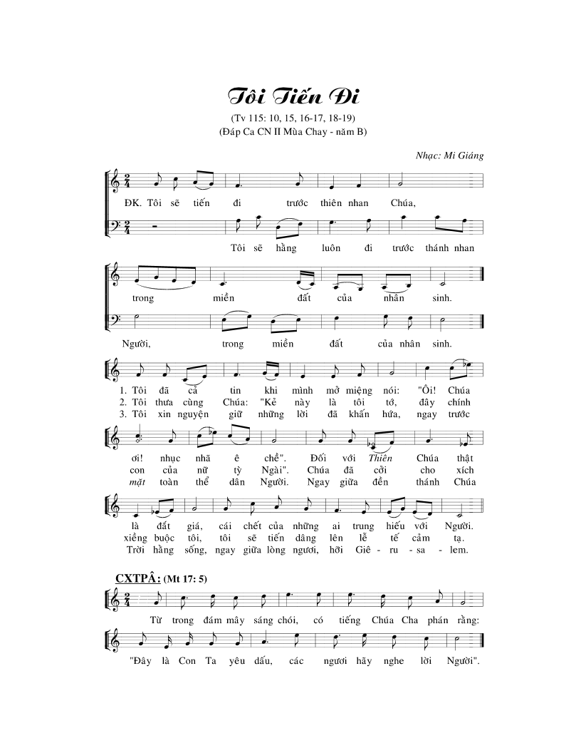
2
2
2
2
2
2 + 3, 4
2
2

Slide 2
2
2
2
2
2 + 3, 4
1, 2
2
2
2
2

